Slide 1
ASP.NET Core Blazor Komponenty

Slide 2
Komponenty
A component is a self-contained chunk of user interface (UI), such as a page, dialog, or form.
A component includes HTML markup and the processing logic required to inject data or respond to UI events.

Slide 3

Komponenty
Razor
Kompilace
Parametry
Události
Partial classes, base classes
Raw HTML
Cascading values and parameters
Stránky

Slide 4
Razor - .razor
HTML, resp. html
C#
@ (ale nikoliv v atributech a emailových adresách)
@(...)
@{...}
@@
<text></text>

Slide 5
Razor
Dnes: @DateTime.Today.ToShortDateString()
Zítra: @((DateTime.Today + TimeSpan.FromDays(1)).ToShortDateString())
@Username → hodnota vlastnosti username
@@Username → @Username
@((MarkupString)"<span>Hello World!</span>")

Slide 6
Razor – control structures
@if, else/else if, @switch
@for, @foreach, @while, @do
@try, catch, finally
@lock

Slide 7
Razor – directives
@attributes
@code
@implements
@inherits
@inject
@layout
@model
@namespace
@page
@using

Slide 8
Razor – directive attributes
@attributes
@bind-…, @bind-…:after
@on{EVENT}
@key
@ref
@typeparam

Slide 9
Razor – ukázka
<ul>
@foreach (var person in people)
{
<li>Name: @person.Name</li>
}
</ul>

Slide 10
Komponenty

Slide 11
Komponenty
WebForms | Blazor
Button | – (html button)
TextBox | InputText
CustomValidator | (data annotations validation)
Repeater | – (@for, @foreach)
GridView | – (QuickGrid) serves as a reference architecture and performance baseline for building data grid components
… | …

Slide 12
Komponenty
Radzen Blazor Components (https://blazor.radzen.com/)
MudBlazor (https://mudblazor.com/)
Telerik UI for Blazor (https://www.telerik.com/blazor-ui)
Syncfusion (https://www.syncfusion.com/blazor-components)

Slide 13
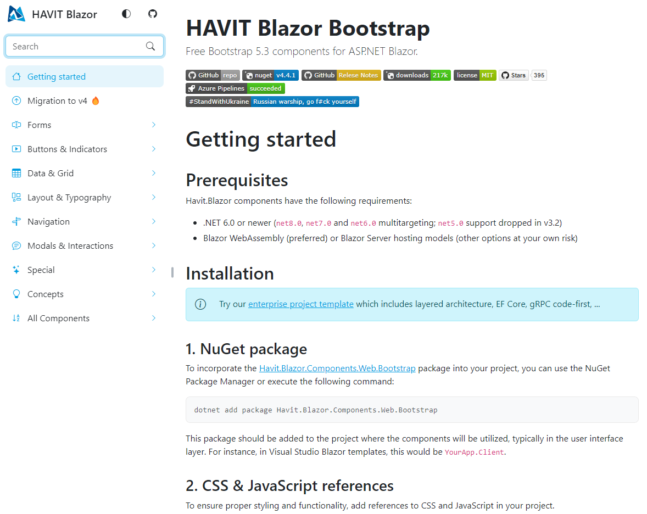
HAVIT Blazor
Blazor & Bootstrap 5
https://havit.blazor.eu

